Slide 1
Making Recommendations
Multifaceted Product Recommender by Walker McFarlan

Slide 2
The Problem
Vendors are looking for interested consumers
Consumers are looking for products they will enjoy
The Solution
A well designed recommender capable of creating accurate predictions for each user’s unique profile.

Slide 3
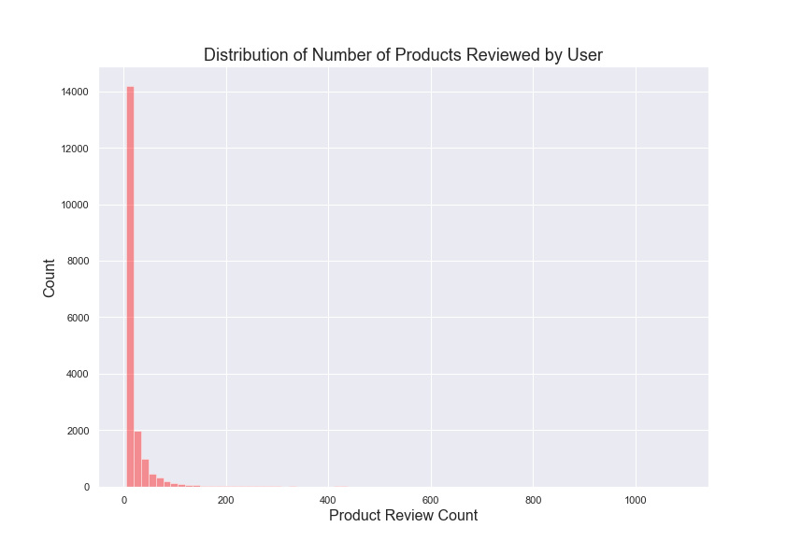
The Data
Amazon health product sales data collected from UCSD’s amazon repository from 2002 to 2014
346,355 unique purchases
from 38,609 unique users
18,534 unique products.
All products have been reviewed at least 5 times, all users have at least 5 reviews

Slide 4
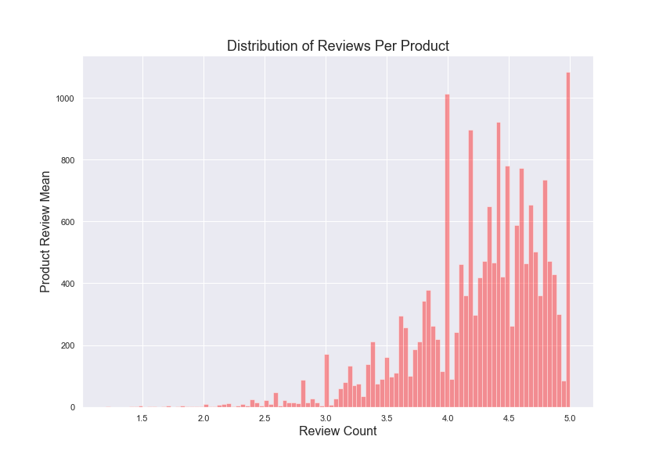
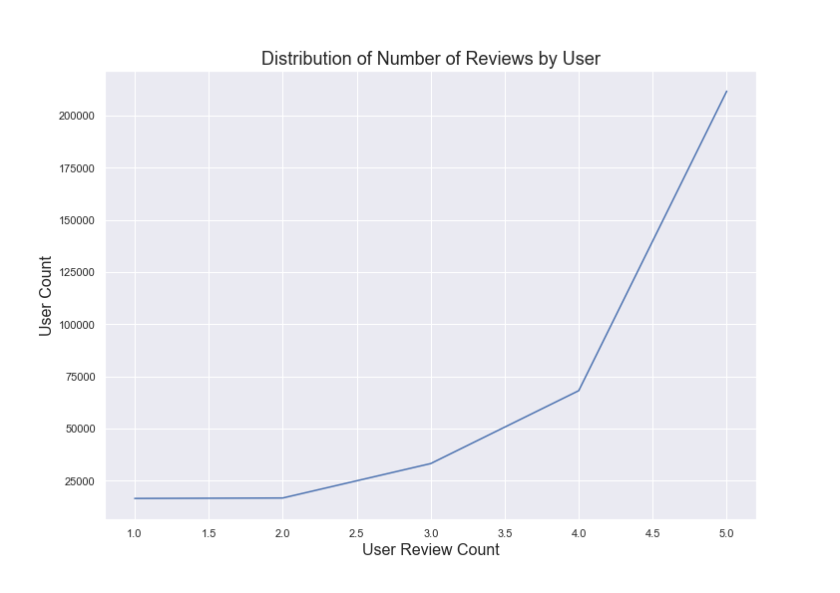
Distribution of Reviews
Most products are rated between 4 and 5
Most reviewers rate products highly

Slide 5
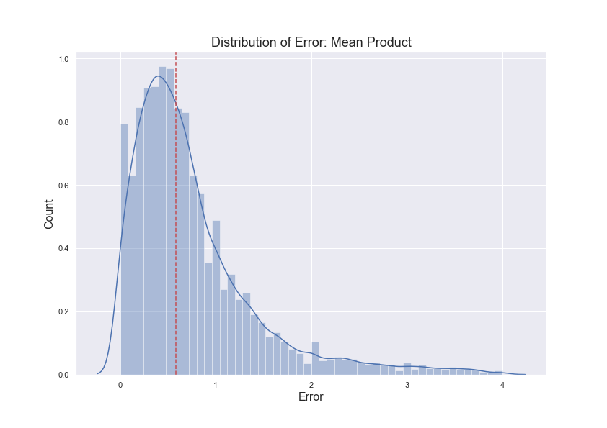
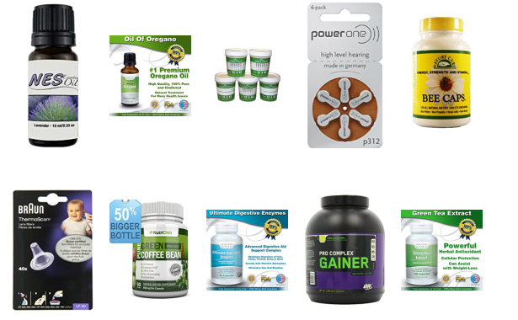
Baseline Recommender: Product Mean
Each product has their overall ratings averaged
Each user is recommended top 10 highest rated products
RMSE: 1.04
The Problem
Products with very few reviews that average out to a 5 are over represented
This approach can be easily manipulated scammers
Product Mean does not account for a users preference or any relationship between product to product

Slide 6
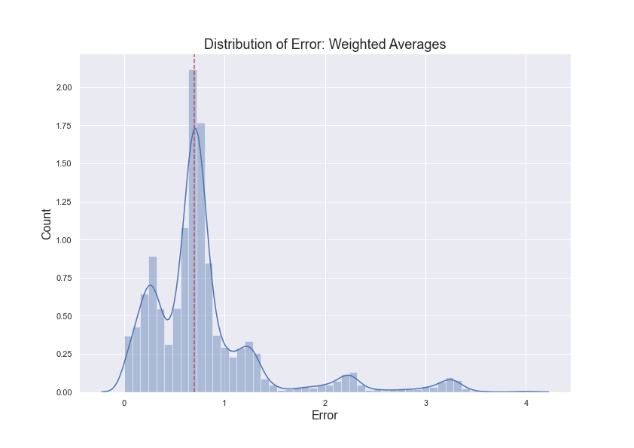
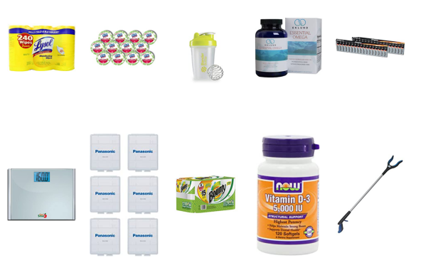
The Cold Start Problem
How do we recommend to new users without prior information about their shopping habits?
Cold Start Solution: Weighted Average
Each product has their overall score averaged
Products with less than 50 reviews are penalized
RMSE: 1.004
New users would have the top 10 currently highest rated products recommended to them

Slide 7
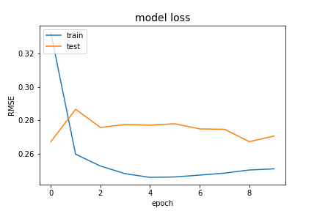
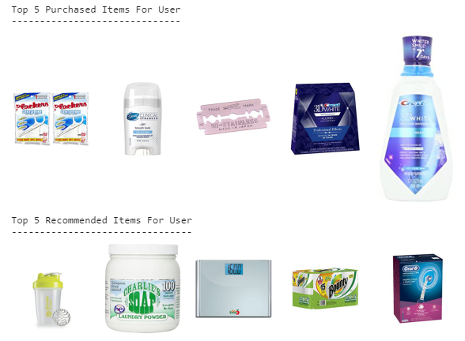
Final Predictive Model
After testing multiple models and approaches, an embedded neural network built on Keras architecture was selected
Using Collaborative Filtering, products and users are transformed with embedding layers designed to find similarities between products and users.
This approach was more capable of dealing with non-linearity in the data and out performed traditional models
After tuning, an RMSE of 0.27 was achieved

Slide 8
Future Work
Integrate other amazon product categories
Upscale to larger data
Find user data to integrate into modeling (age, sex, etc.)
Build to production

Slide 9
Questions?

